Slide 1
Intra-pulse feedback in pulsed RF Linacs
Nate Lipkowitz, SLAC
Low-Level RF Systems
USPAS January 2017

Slide 2
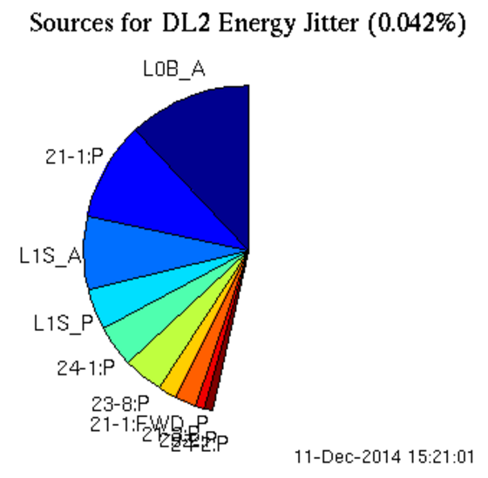
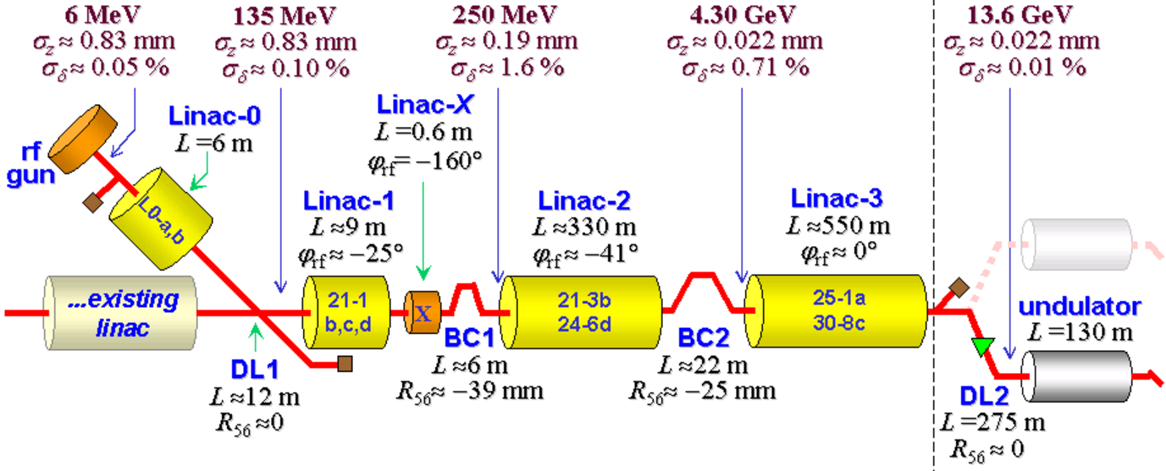
Pulsed RF Linac
T_{rep}
T_{rep} >> T_{RF}
T_{RF}
Why do I care?
SLAC linac (LCLS, FACET): T_{rep} = 1/120 pps = 8.3 ms; T_{RF} ~ 5 µs
Pulse-to-pulse stability dominated by RF jitter of a few stations
Inter-pulse feedbacks exist, but open loop intra-pulse
Experiments often limited by longitudinal jitter!

Slide 3
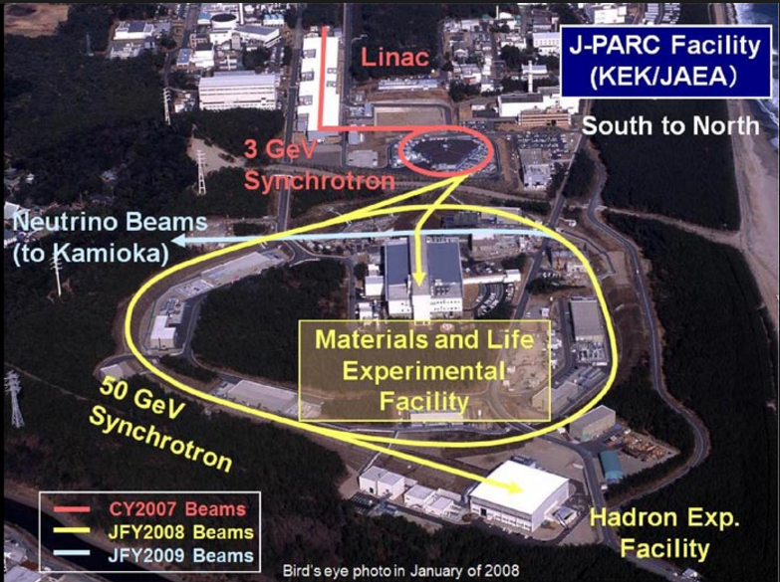
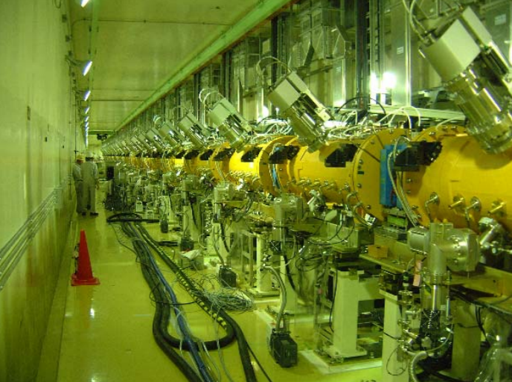
J-PARC Linac
J-PARC Linac provides a 181-MeV proton beam to the 3-GeV rapid-cycling synchrotron (RCS)
“the maximum RF pulse width is 620 μs … repetition is 25 pps”

Slide 4
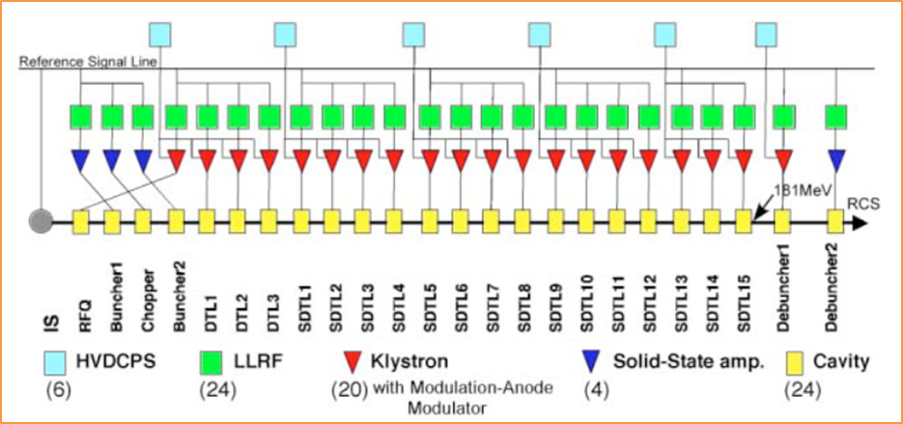
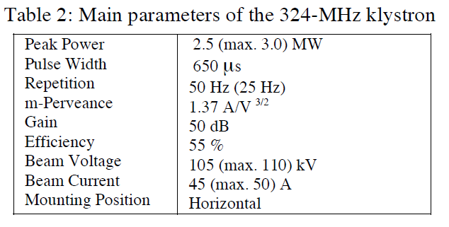
J-PARC Linac RF System
“… keep the cavity field stability within ±1% in amplitude and ±1° in phase…”
“… main factors of the instability are the voltage sag and the pulse-to-pulse fluctuation of the klystron DC power supply, the temperature drift and the beam loading.”

Slide 5
J-PARC Station LLRF
T_{rep} = 20 ms; T_{RF} = 700 µs

Slide 6
J-PARC Station LLRF
T_{rep} = 20 ms; T_{RF} = 700 µs
“An analogue fast FB … in order to make the klystron to act an ideal linear amplifier.”
“Not used in the present operation because only the digital FB control sufficiently satisfies the required stability”

Slide 7
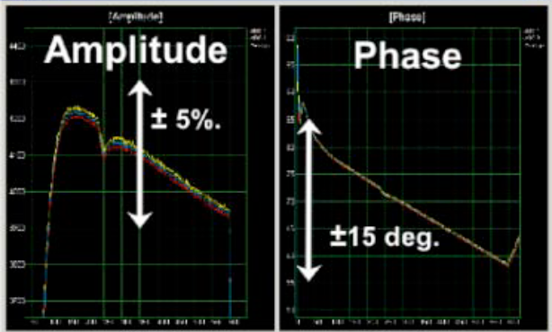
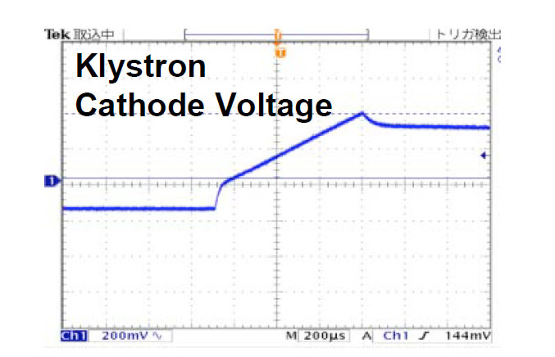
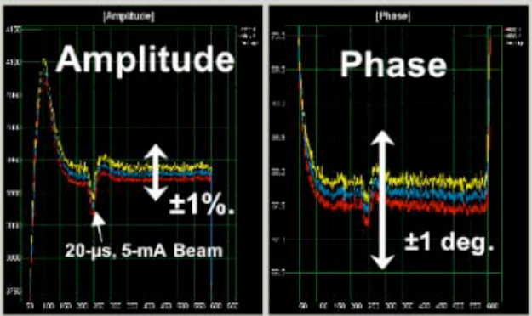
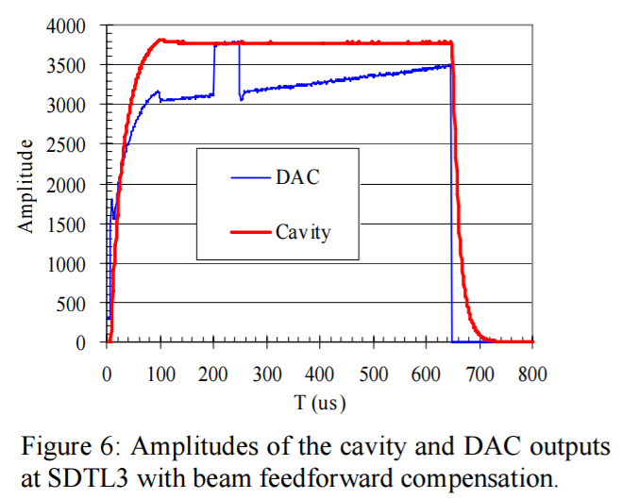
Digital feedback
3% voltage sag drives 30-deg phase excursion
Open
Loop
T_{RF} = 700 µs
RF drive
Closed
Loop
Beam loading corrected by feedforward

Slide 8
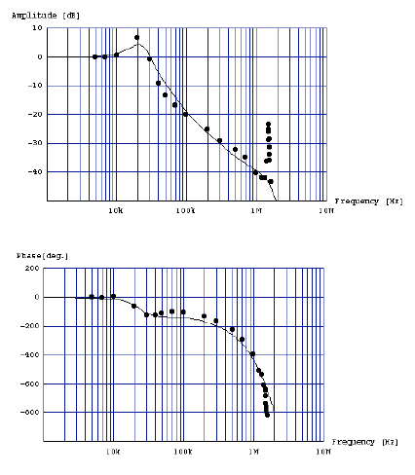
Analog feedback on cavity signal
τ_{i} = 95 μs
τ_{C} = 22 μs
τ_{k} = 9.9x10⁻⁸
α = 1.2x10⁻¹⁴
T_{d} = 0.8 μs
T_{d} limits the feedback response at high ω
Performance Study of Low-Level RF Analog Feedback Control System for J-PARC Linac
T. Kobayashi et al, Proceedings of 2nd Annual Meeting of Particle Accelerator Society of Japan

Slide 9
What about a faster time scale?
SwissFEL at PSI
3 μs RF pulse, HV modulator
Analog PI controller
T_{d} = 100 ns
“In the lab test a control bandwidth of 1MHz has been measured”
Intra Pulse Phase Control
M. Bronnimann, PSI, LLRF Workshop 2015

Slide 10
PI Controller
T_{d} = 100 ns
“In the lab test a control bandwidth of 1MHz has been measured”

Slide 11
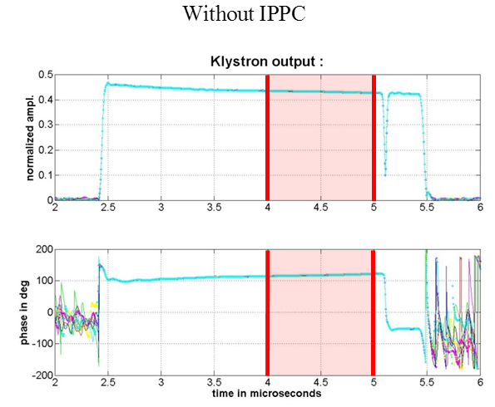
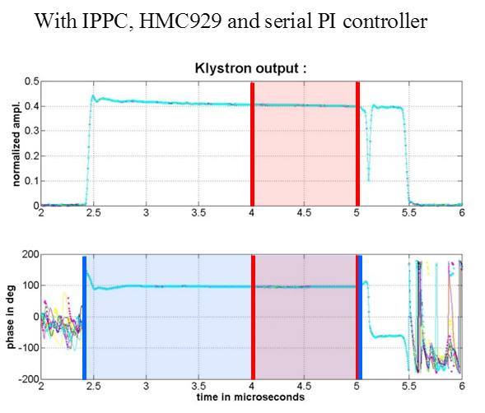
Intra pulse phase correction
measurement | Intra pulse phase stv. dev. in degree | P2p phase jitter in degree
Without IPPC | 2.01 | 0.046
IPPC in open loop | 2.03 | 0.047
IPPC in closed loop | 0.37 | 0.017

